Slide 1

How do Knowledge Graphs Relate to AI?

Slide 2
Outline
Knowledge Graphs as a Test Bed for AI
Graph Data Science
Knowledge Graphs for the ultimate vision of AI

Slide 3
Knowledge Graphs as a Testbed for AI
Two-way symbiosis
Knowledge Graphs enable many AI applications
AI algorithms can be used to create Knowledge Graphs

Slide 4
Knowledge Graphs as Enablers of AI
Knowledge Graphs enable
A personal assistant to get more things done
A recommendation system to offer better recommendations
A search engine to answer questions

Slide 5
AI as an Enabler for Knowledge Graphs
Machine learning / NLP algorithms play a central role in
Schema mapping entity linking
Entity and relation extraction
Data cleaning and anomaly detection
Inference and question answering

Slide 6
Graph Data Science
Availability of huge amount of data
Derive knowledge from the structure in data

Slide 7
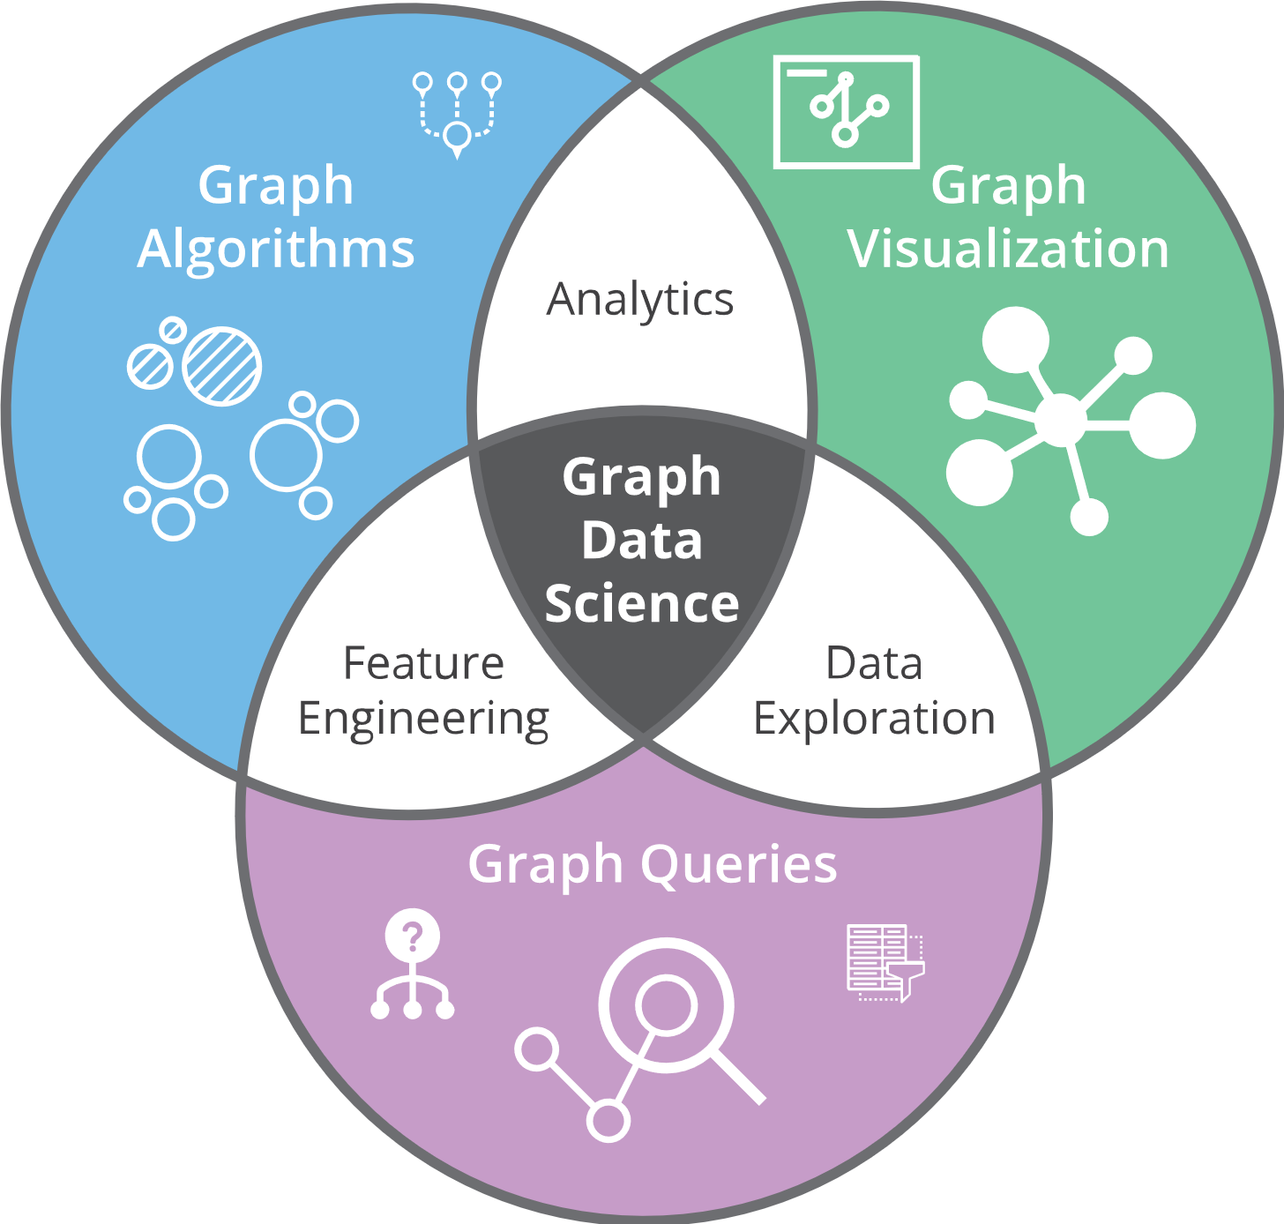
Graph Data Science

Slide 8
Graph Data Science
Use Machine Learning for Predictions

Slide 9
Graph Data Science
Use Machine Learning for Predictions
Requires Feature Engineering

Slide 10
Graph Data Science
Use Machine Learning for Predictions
User Experience for Large Datasets
Requires Feature Engineering

Slide 11
Knowledge Graphs for AI
Knowledge Graphs have been used in AI since the beginnings
Semantic networks
Description Logics
Rule Languages
Graphical Models

Slide 12
Knowledge Graphs for AI
But Knowledge Acquisition has been an equally central concern
Semantic networks
Description Logics
Rule Languages
Graphical Models
Knowledge Engineering
Inductive Learning
Machine Learning

Slide 13
Knowledge Graphs for AI
But Knowledge Acquisition has been an equally central concern
Semantic networks
Description Logics
Rule Languages
Graphical Models
Knowledge Engineering
Inductive Learning
Machine Learning
Machine Learning/NLP scale where knowledge engineering does not

Slide 14
Knowledge Graphs for AI
But Knowledge Acquisition has been an equally central concern
Semantic networks
Description Logics
Rule Languages
Graphical Models
Knowledge Engineering
Inductive Learning
Machine Learning
Machine learning scales where knowledge engineering does not
Only partially true

Slide 15
Knowledge Graphs for AI
But Knowledge Acquisition has been an equally central concern
Semantic networks
Description Logics
Rule Languages
Graphical Models
Knowledge Engineering
Inductive Learning
Machine Learning
Machine learning scales where knowledge engineering does not
Only partially true
Scale is achieved by sacrificing accuracy, explanation, human understanding

Slide 16
Knowledge Graphs for AI
But Knowledge Acquisition has been an equally central concern
Semantic networks
Description Logics
Rule Languages
Graphical Models
Knowledge Engineering
Inductive Learning
Machine Learning
Machine learning scales where knowledge engineering does not
Only partially true
Scale is achieved by sacrificing accuracy, explanation, human understanding
Many applications where these features still matter

Slide 17
Knowledge Graphs for AI
But Knowledge Acquisition has been an equally central concern
Semantic networks
Description Logics
Rule Languages
Graphical Models
Knowledge Engineering
Inductive Learning
Machine Learning
Programs that have a model of the domain, formulate a hypothesis, design an experiment, provide explanations, remain an open challenge for AI

